Slide 1
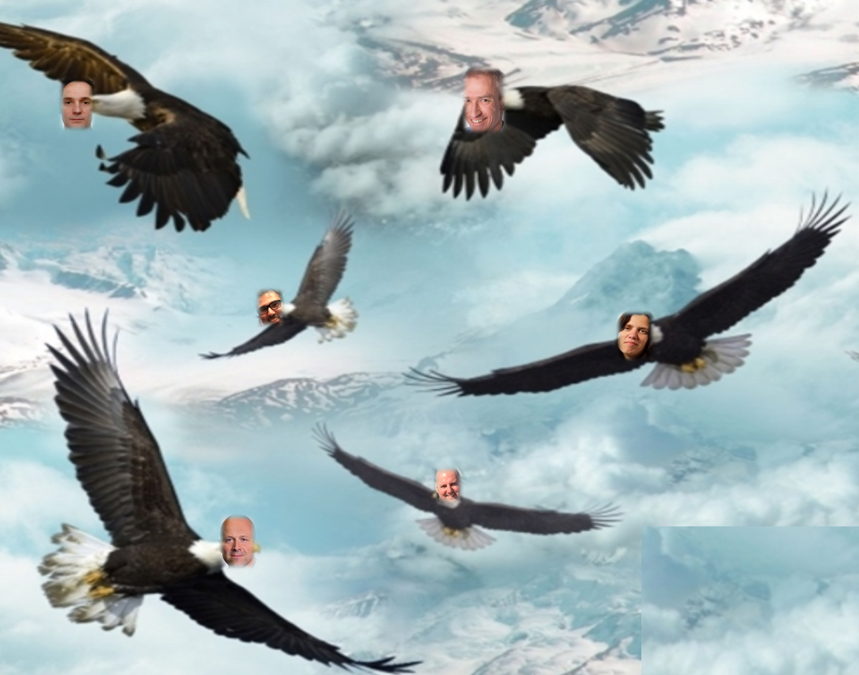
Soaring through the Clouds – The Sequel Low TCO Cloud Native Microservices Solution
Oracle Open World 2018
San Francisco, October 2018

Slide 2








Slide 3
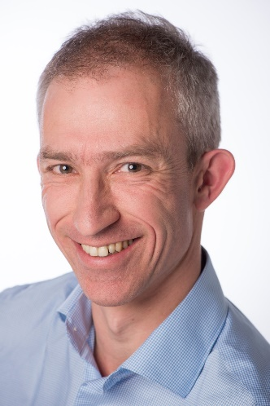
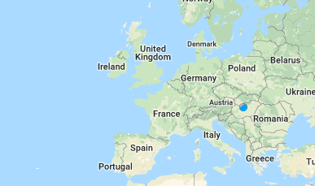
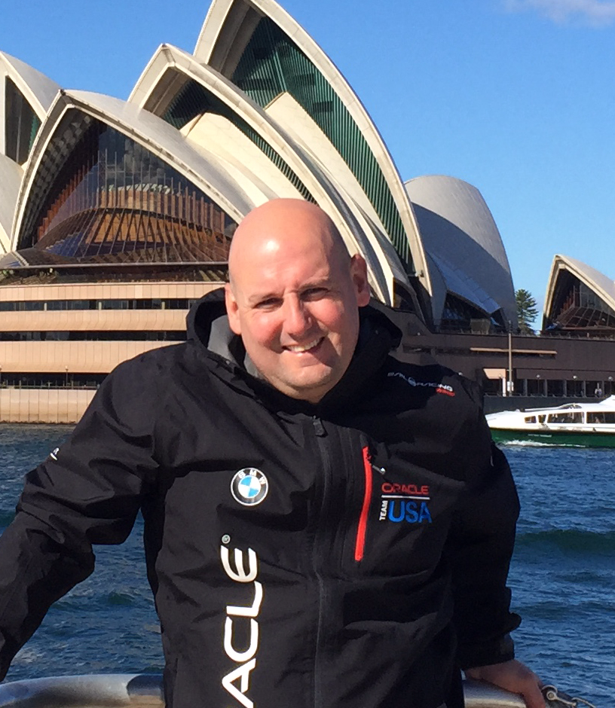
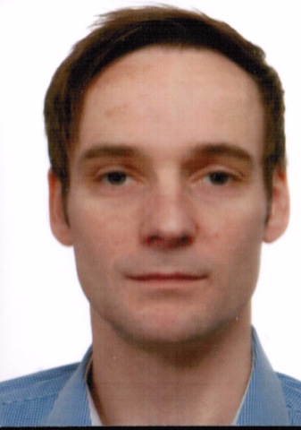

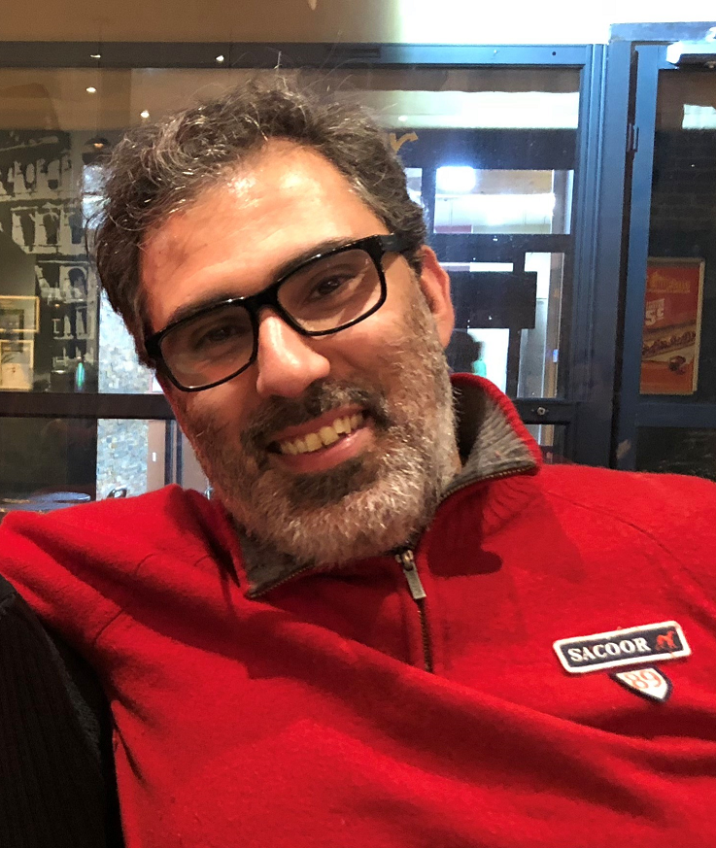
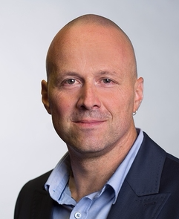
The Team

Slide 4
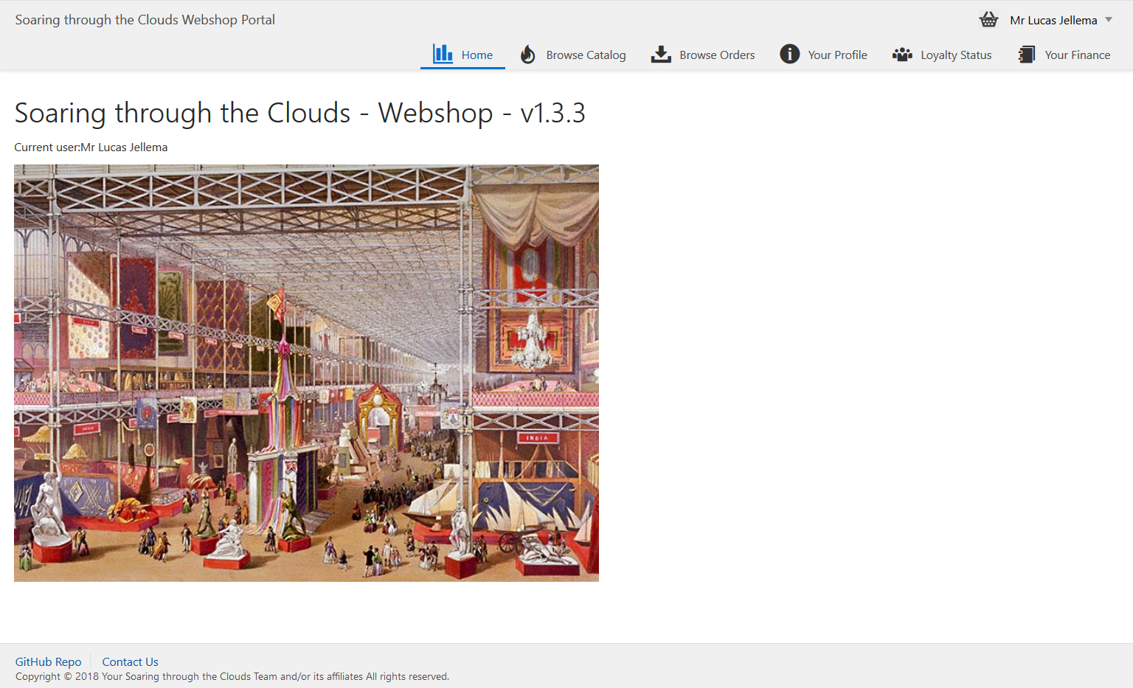
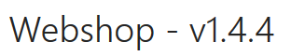
Meet Our Web Shop
Notes:
start with a demo of the Webshop - from customers signs and browses the products catalog to check out of the shopping basket, composing the order with delivery details and submitting the order; then checking the invoices and perhaps making the payment, reviewing the loyalty points and status and finally checking on the order progress (as the order gets picked, shipped and finally delivered).

Slide 5
What’s the IT behind the Webshop?
Web Shop Portal
µ Customers
µ Orders
µ Products
µ Loyalty
µ Finance
µ Logistics
µ Customers
µ Orders
µ Products
µ Loyalty
µ Finance
Notes:
dazzle the audience with a quick dump of all technologies (and cloud services) used for putting the webshop together - for the UI, the API implementation, the datastores and the event bus.

Slide 6
Microservices Architecture
Microservices are not the silver bullet!
Important concepts:
Choreography (vs. Orchestration in classic SOA environments)
Bounded Context (Domain Driven Design)
DevOps: Teams taking ownership for Dev & Ops (”You built it, you run it!”)
But: Good fit for our use case, since increased
Flexibility: Comprehensible, maintainable, independently releasable
Scalable
Fault tolerant & robust
Benefit from technological innovation (without enterprise risk & impact)
Notes:
spend a little time on microservices - why decided to apply a microservices architecture (objectives, expectations) and how we designed the architecture in our case (link to Omesa?). What were the rules and assumptions. Here we can perhaps show how we use Slack and GitHubExplain in some details what important role events played. Maybe at that point also discuss the workflow (@Luis Weir’s article and our discussions around that).Perhaps we can use the Event Monitor Dashboard (that shows all on EventHub/Kafka events on a timeline ) to illustrate the story on the events (and the Order workflow)

Slide 7
Microservices Architecture Design & Implementation Characteristics (12-factor)
Are encapsulated and stand-alone
Stateless and horizontally scalable
Offer REST APIs
Expose configurable properties – such as endpoints of dependencies
Are released & deployed & scaled independent of each other
They can be co-located but they do not have to
Continuous Delivery – including automated build and test – are applied
Publish events and consume (relevant) events from central event bus
Are responsible for their own data
take care of persistence in a fitting data store
Also manage the bounded context: data owned by/derived from other microservices that the service requires to function independently and at speed
Even though not required, containers are a popular vehicle for build, ship and run
Kubernetes is becoming the de facto standard container management runtime platform
Notes:
spend a little time on microservices - why decided to apply a microservices architecture (objectives, expectations) and how we designed the architecture in our case (link to Omesa?). What were the rules and assumptions. Here we can perhaps show how we use Slack and GitHubExplain in some details what important role events played. Maybe at that point also discuss the workflow (@Luis Weir’s article and our discussions around that).Perhaps we can use the Event Monitor Dashboard (that shows all on EventHub/Kafka events on a timeline ) to illustrate the story on the events (and the Order workflow)

Slide 8
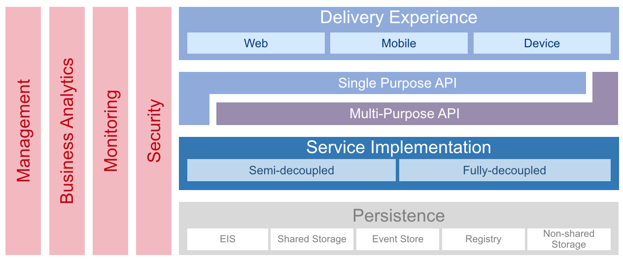
Architectural foundation: OMESA
http://omesa.io

Slide 9
Safe Harbour Statement
Everything, what we‘ll show you in the following has been developed on a greenfield.
We are a loosely-coupled, self-organizing and small group without major organizational restrictions, but with dedicated responsibilities. It was sometimes more challenging than it appears in this presentation. Implementing a Microservice architecture is challenging, even though the context is manageable.
Notes:
Unsure, if we‘ll show thtat slide. My intention is to not only to make a joke, but to make it clear to the audience that everything we tell them within the session is experience from a project that we built under laboratory conditions; in reality – especially in grown organizations – introducing Micorservices will become even more harder...

Slide 10
Why did we choose a µServices Architecture?
Decoupled development
Acurate need for coordination
Async, on-demand communication (no fixed Jour Fixes)
Dedicated responsibility and ownership
Flexibility and different skill sets
Technologies
Platforms

Slide 11
How did we find the right service granularity?
We didn‘t, because there is no definitive solution, because of changes in
Organizations
Business objectives
Technology Frameworks
Regulations
But, we quickly started with a first idea of Bounded Context, APIs, etc.
Service cut is not carved in stone and needs revision in every iteration
#doneisbetterthanperfect
#stopdiscussingstartdoing
#embracechange

Slide 12
How did we agree the technology platform?
Technology platform is not significant, even though it‘s important to keep it flexible and exchangable
Focus should be on the Business challenges that should be solved
Main objective:
Sustainable manageable agility in functionality and non-functionality (scale, performance, location, availability, ..) - with optimal cost (low), speed (high), risk (low) of running and evolving our business application landscape. The evolution of the underlying technology and architecture is very much to be included

Slide 13
TCO considerations for software solutions
Capital expenses
Hardware costs
Software licenses
Operating expenses
Organizational (IT personell, Training, Insurance, Security, Audit)
Infrastructure (Floor space, electricity)
Scalability / Upgrade expenses
Replacement / Decommisioning
Indirect costs
Downtimes
Time-to-market delays
Notes:
With respect to on-premises solutions, what needs to be taken into account?

Slide 14
Captial expenses for our Webshop solution
Completely Cloud-based solution
No hardware costs
No software licenses needed
No capital expenditures, only Operational expenditures (CaPex to OpEx)
Costs for respective Cloud subscriptions
Pay-as-you-Go
Monthly Flex model
(Nearly) Unlimited scalability

Slide 15





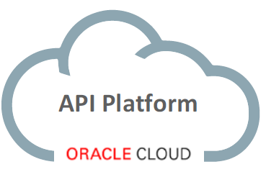








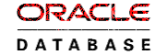







API Portal
Web Shop Portal
µ Customers
µ Orders
µ Products
µ Loyalty
µ Finance
API Platform
Backoffice UI
λ
Event Schema Registry
Event Hub
Notes:
dazzle the audience with a quick dump of all technologies (and cloud services) used for putting the webshop together - for the UI, the API implementation, the datastores and the event bus.

Slide 16
Organizational apsects
Challenges
Chances
Re-organization needed (DevOps)
Cultural change
„Fail fast!“
„You build it, you run it!“
People need to embrace changeability
Responsibility: Developers must be architects and vice-versa
Dedicated ownership leads to more sense of responsibility
Code quality
Security
Bugfix efficiency
Increased development efficiency
Technology flexibility
Technical expertise in team
DevOps

Slide 17





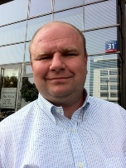
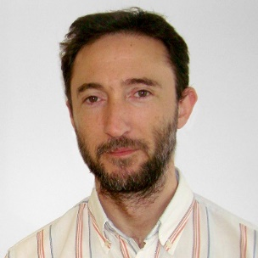
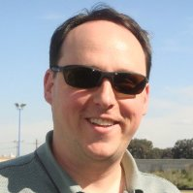
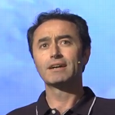

Team organization with dedicated responsibilities
Web Shop Portal
µ Customers
µ Orders
µ Products
µ Loyalty
µ Finance

Slide 18
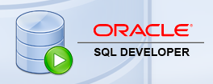

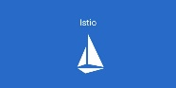
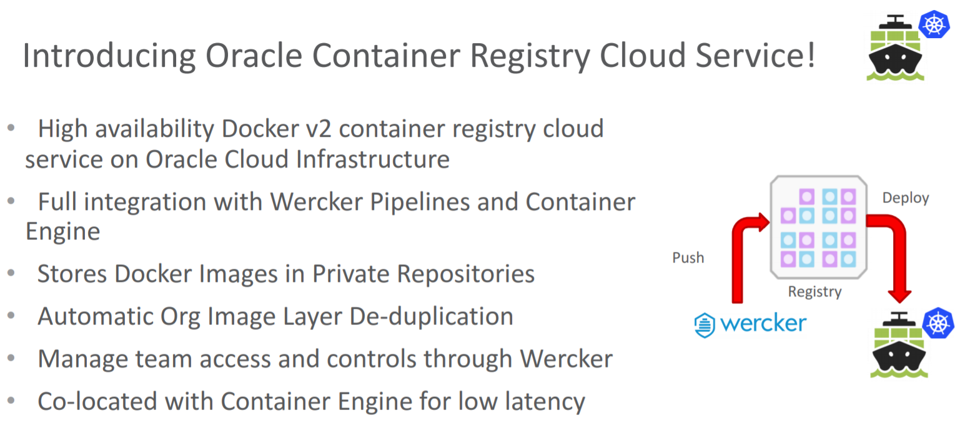





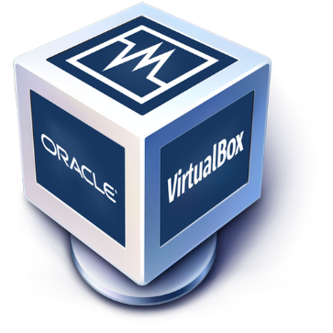

Toolbox

Slide 19
Establish refactoring as a regular activity
There are many factors from different areas, which need to be taken into account:
Business
Organization
Architecture
Technology
Non-Functionality
Operational
Notes:
Doing refactorings on a regular basis means that an organization won‘t have any difficulties with doing refactorings with justifiable expenses

Slide 20
Splitting or Merging µService on-demand
Merging
Less frequent use case
No justification for having 2 µServices
Effort for merging is acceptable
Splitting
Regular use case
Context has disjunctive business functionaity
Challenge: Split-off the data

Slide 21
Operating expenses for our Webshop solution
(Nearly) Unlimited scalable and flexible runtime platform
Scaling-up: Scalability on a µServices-level
On-demand
Might be automatically be done by the platform itself (e.g. K8s)
Scaling-out: Scalabilty on a platform-level
Fine-granular upgrade possibilities on a µService level
Other µServices are not affected
Quickly and simple rollback capabilities
Service isolation and Bounded Context
Data sovereignty
Clear data access thorugh well-defined APIs
Notes:
Replacement and Decommissioning of Services is easily be done and guarded by a respective Governance process

Slide 22
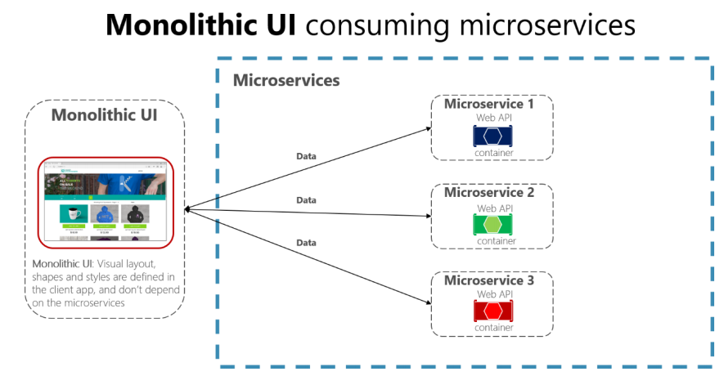
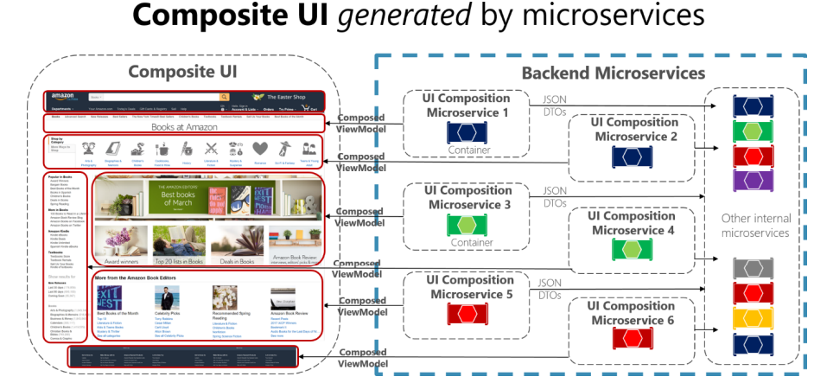
µServices Architecture also for User Interface
Is UI part of Microservice?
VS.
Notes:
spend a little time on microservices - why decided to apply a microservices architecture (objectives, expectations) and how we designed the architecture in our case (link to Omesa?). What were the rules and assumptions. Here we can perhaps show how we use Slack and GitHubExplain in some details what important role events played. Maybe at that point also discuss the workflow (@Luis Weir’s article and our discussions around that).Perhaps we can use the Event Monitor Dashboard (that shows all on EventHub/Kafka events on a timeline ) to illustrate the story on the events (and the Order workflow)

Slide 23
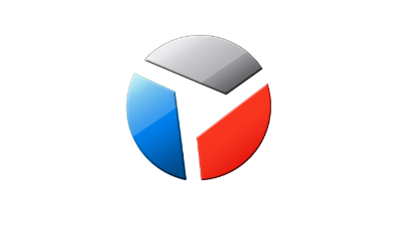
Service isolation ensures scalability & upgradeability
Web Shop – Customer User Interface
CustomerSignIn,
ChangedProfileSettings
Client Side (JS) Event Bus & Routing
Context (user settings, navigation history, ..)
Menu & Nav
Marketing content
IFRAME
IFRAME
IFRAME
IFRAME
IFRAME
ViewProduct
InspectInvoice
AddToBasket
Sign Up
Sign In
Edit Profile
µ Customers
µ Orders
µ Products
µ Loyalty
µ Billing, Invoicing & Collection

Slide 24
Service isolation and Bounded Context
Data should be part of the Bounded Context
No direct data access from external services, indepent if data is stored
As part of the container
Outside the container
Access solely by using the provided Microservice APIs
Data stored as part of the container
Data stored outside the container
Web Shop Portal
µ Orders UI
µ Products UI
µ Loyalty UI
API
{ }
µ Orders
µ Products
µ Loyalty
Event-Hub

Slide 25
Live-Demo: Scalability
Notes:
Not sure, if we have to time for that; respectively if we have the time to prepare a Showcase for this one

Slide 26
Our solution: Time-to-Market
Increased time-to-market due to:
Event-first approach (Service choreography)
API-first approach (UI integration)
Consistent CI/CD integration
Use of new development tools and platforms
Decoupled archtiecture allows to release µServices high-frequently and without influencing the overall platform stability
Independent µService development, because of dedicated ownership

Slide 27

Decoupled Development: Event-(First)
Event Monitor
Product Update
Product added to Shopping Cart
Shop
Products
Event Hub (Kafka)
Topic X
Topic Y
Topic Z
Topic Q
New Customer
Customer Profile Changed
Customer Sign In
Customers
Order Payment Received
Customer Frozen
Customer Loyalty Status Change
Order Create
Order Cancelled
Product Stock Update
Shipping News
Loyalty Program
Order
Logistics
Finance

Slide 28
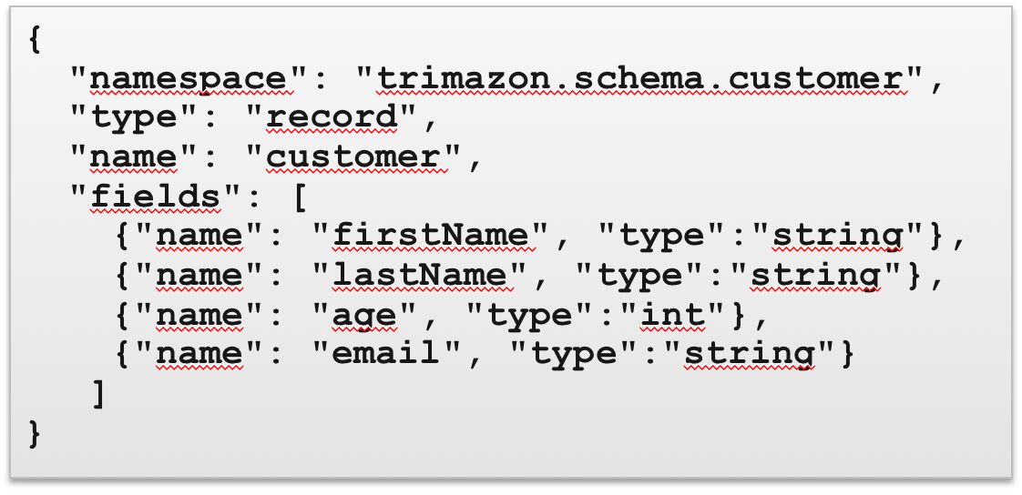
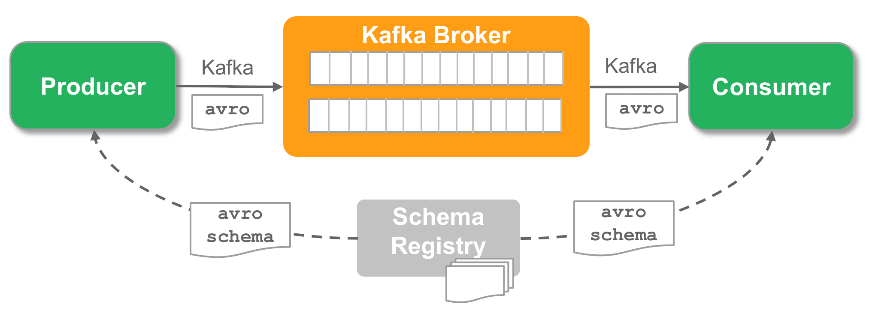
Event-first Governance: Avro and Schema Registry
Apache Avro
Data Serialization system well supported by Big Data ecosystem
Supports many languages
Fast binary data format
Supports schema evolution
Confluent Schema Registry
Provides Avro schemas to producer/consumer
Versioned history of all schemas
Serializers to plug into Kafka clients to work with Schema Registry
Provides REST API and Maven Plugin
Deployed on Oracle Container Service Classic

Slide 29
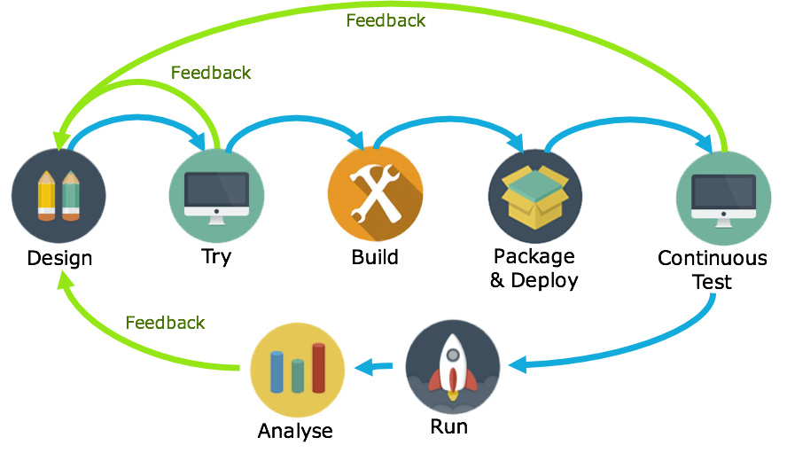
API-Design First
1
Avoid rework: feedback early in the cycle
By getting feedback very early in the lifecycle, changes of rework late in the cycle are slim. Saving time and cost.
2
Parallel development: Decouple App dev from Service dev
By defining APIs with API Blueprints or Swagger, app dev and service dev can occur in parallel.
3
Agile: be ready for change
By continuously verifying service builds against API definitions, non-compliant updates can be detected quickly.

Slide 30











The process looks something like this
Feedback
Feedback
Design
Try
Build
Package & Deploy
Continuous Test
01
02
03
04
05
Create API Blueprint/OAS in Apiary
Use Apiary Mock endpoints to publish an API through the Oracle API platform
API docs and mock endpoints available in the Dev Portal
JET designers/developers try the API and give feedback
Build backend service using tech of choice
Use Dredd to test endpoints against spec
Switch API Gateway routing against tested endpoints
Stablish a CICD pipeline for continuously and consistently packaging and deploying releases, e.g. using Wercker
Set up functional regression testing (e.g. using API Fortress or Postman) to ensure UI functionality doesn’t break due to API changes.
Oracle API Platform
Notes:
curl -X GET http://127.0.0.1:3000
docker exec -it 28f812bf8902 bash register.sh d2VibG9naWM6SUszQVcxbjU= https://oc-144-21-66-168.compute.oraclecloud.com:7202/apiplatform/management/v1/services http://oc-144-21-66-168.compute.oraclecloud.com:3000/orders
Administration: http://docs.oracle.com/en/cloud/paas/api-platform-cloud/apfrm/index.html
Management: http://docs.oracle.com/en/cloud/paas/api-platform-cloud/apfrm/index.html
Developer Portal: http://docs.oracle.com/en/cloud/paas/api-platform-cloud/apfrd/index.html
Gateway controller (not working…): http://docs.oracle.com/en/cloud/paas/api-platform-cloud/apfrg/index.html
Analytics: http://docs.oracle.com/en/cloud/paas/api-platform-cloud/apfra/index.html
Instance lifecycle management: http://docs.oracle.com/en/cloud/paas/api-platform-cloud/apfrl/index.html

Slide 31
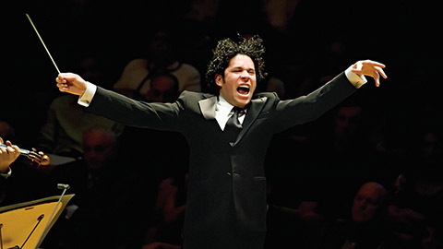

Cross Microservices Workflow
Choreography vs Orchestration – Which one is which?

Slide 32
Orchestration
Choreography
Store Web App
HTTP/JSON 200
{‘outcome’ = ‘processing’}
HTTP/JSON
Store Web App
Outcome
(Websocket, pushNot or Pull)
HTTP/JSON
HTTP/JSON 200
{‘outcome’ = ‘rejected’}
HTTP 202
Accepted
API Gateway
API Gateway
Process Engine
µService
Orchestrated Process
Receive Details
Credit Check
Process
Credit
Process
Credit
Receive Details
Check Credit Score
Good?
Yes
Reject
No
Process
Service
Event Hub
Credit Check
Process
Credit
Credit Check Event
Credit Check
Success
Credit Check
Failed

Slide 33
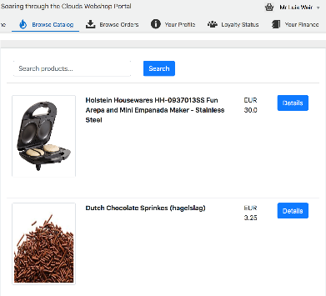
Orders Microservice
1
Items are added to shopping basket. Product MS adds items to topic “add-to-shopping-cart”.
Based on MEON (Mongo, Express, Oracle JET, Node.JS)
Oracle
Kubernetes
Engine (OKE)
(AD1) Container
AD2
AD = Availability Domains
2
AD3
”Product Subscriber Service” receives the items added. Then based on the Customer ID, checks if a Shopping Cart exists. If yes, adds the items to the basket. If no, creates a new Shopping Cart and then adds the item. This verifications occur by calling Orders Service via HTTP binding (but using K8s Service Name).
Orders
UI
3
API Gateway
Oracle API Platform Cloud Service
Ingress LB
3
A user initiates the checkout process. During the process, the UI interacts with not just Orders MS API, but other APIs such as Customer (for getting the Customer Details, and Logistics for checking stock availability and shipping price.
Container
HTTP Binding
(K8S DNS)
Container
HTTP Binding
(K8S DNS)
Container
API Gateway
Product
Subscriber
Service
Order
Producer
Service
Orders
2
4
Customer
Logistics
Container
Mongo
4
Once the checkout process completes, an assuming that all details of the Order are verified, then the Order changes status to “SUCCESS” and and event is added to topic “order-created”.
Logistics
Event Hub CS
Loyalty
1
5
Logistics, Finance and Loyalty MS pick up the event for further processing.
Finance
5

Slide 34
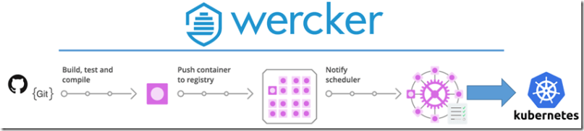
Faster time-to-market with Continuous Delivery and Deployment
Logistics MS
Change API definition
Commit and Push
Trigger build pipeline in Wercker
Show result in Kubernetes, K8S dashboard,
Proof that the change is there from call to API (in browser or postman)

Slide 35
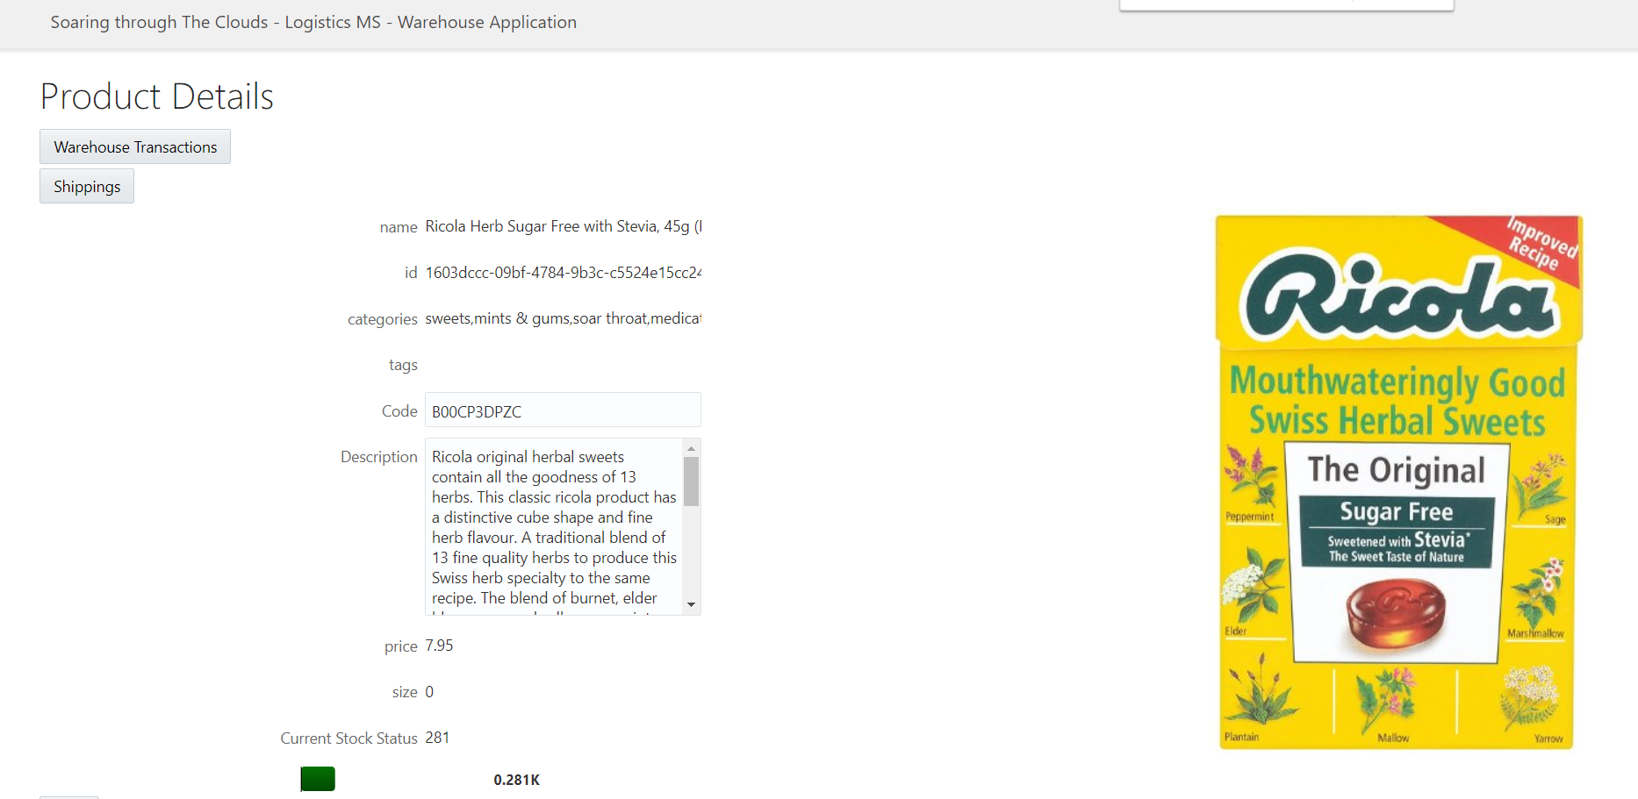
Rapid UI development using Next Gen VBCS leveraging the API change
Back Office UI for Logistics (built with VBCS against the REST APIs of the Logistics MS)
Objective: add a new page that shows all shippings that contain the selected product
Steps:
Create service connection for the new API Endpoint
Create a new page for shippings
Add table to page – based on the new API endpoint
Create button on Product Detail page to navigate to the new page
Run the application

Slide 36
Summary
TBD

Slide 37
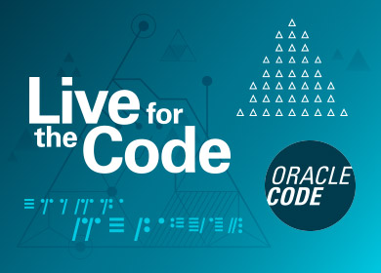



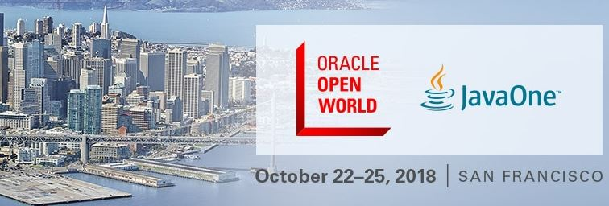


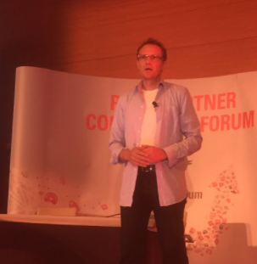

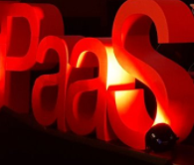
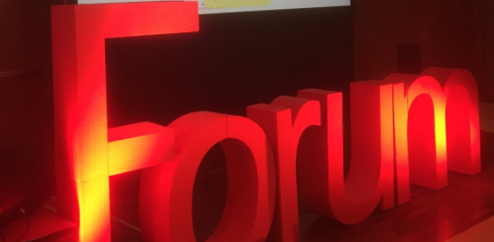
2019

